Slide 1
Candidate marker detection and multiple testing

Slide 2
Outline
Differential gene expression analysis
  Traditional statistics
    Parametric (t statistics) vs. non-parametric (Wilcoxon rank sum statistics )statistics
  Newly proposed statistics to stabilizing the gene-specific variance estimates
    SAM
    Lonnstedt’s Model
    LIMMA

Slide 3
Outline
Multiple testing
  Diagnostic tests and basic concepts
  Family wise error rate (FWER) vs. false discovery rate (FDR)
  Controlling for FWER
    Single step procedures
    Step-down procedures
    Step-up procedures

Slide 4
Outline
Multiple testing (continued)
  Controlling for FDR
    Different types of FDR
    Benjamini & Hochberg (BH) procedure
    Benjamini & Yekutieli (BY) procedure
  Estimation of FDR
  Empirical Bayes q-Value-Based Procedures
  Empirical null
  R-packages for FDR controls

Slide 5
Differential Gene Analysis
Examples
  Cancer vs. control.
  Primary disease vs. metastatic disease.
  Treatment A vs. Treatment B.
  Etc…

Slide 6
Select DE genes
 | Tumor | Tumor | Tumor | Tumor | Normal | Normal | Normal | Normal
31308_at
31309_r_at
31310_at
31311_at
31312_at
31313_at
31314_at
31315_at
31316_at
31317_r_at
31318_at
31319_at
31320_at
21.0199 | 29.1547 | 17.9257 | 20.3766 | 19.8673 | 18.4821 | 17.9005 | 20.863
46.0512 | 48.7559 | 43.1192 | 46.5921 | 25.2423 | 33.0099 | 30.2182 | 27.3594
20.3716 | 27.6846 | 20.7468 | 18.5927 | 16.1071 | 15.4484 | 16.9989 | 16.1746
75.6513 | 94.4134 | 80.6328 | 84.4216 | 71.8248 | 69.553 | 78.4236 | 71.5484
97.5175 | 154.163 | 90.5806 | 118.928 | 115.495 | 130.89 | 100.678 | 89.8753
50.9551 | 58.7498 | 54.0995 | 46.8968 | 61.6732 | 62.3931 | 64.7219 | 57.7332
52.2138 | 62.3064 | 59.9553 | 54.8983 | 77.118 | 61.0678 | 84.1336 | 82.37
315.543 | 252.801 | 204.426 | 265.601 | 224.804 | 225.89 | 139.36 | 177.225
12.2335 | 12.163 | 8.8393 | 10.0476 | 13.2467 | 13.3113 | 12.7941 | 10.0831
361.66 | 423.547 | 331.67 | 404.61 | 260.041 | 295.872 | 235.307 | 209.306
19.4059 | 26.4248 | 17.1136 | 16.5311 | 12.6095 | 15.2638 | 13.262 | 15.527
159.305 | 120.841 | 120.867 | 117.889 | 124.751 | 122.684 | 116.257 | 123.107
309.203 | 273.927 | 226.194 | 342.061 | 267.247 | 299.116 | 269.536 | 240.244
No
Yes
Yes
??
No
??
Yes
Which genes are differentially expressed between tumor and normal?

Slide 7
Traditional Statistics
T-statistics

Slide 8
Traditional Statistics
Wilcoxon Rank Sum Statistics

Slide 9
Compare t-test and Wilcoxon rank sum test
If data is normal, t-test is the most efficient. Wilcoxon will lose some efficiency.
If data not normal, Wilcoxon is usually better than t-test.
A surprising result is that even when data is normal, Wilcoxon only lose very little efficiency.
Pitman (1949) proposed the concept of asymptotic relative efficiency (ARE) to compare two tests. It is defined as the reciprocal ratio of sample size needed to achieve the same statistical power.
If t-test needs 100 samples, we only need n₂=100/0.864=115.7 samples for Wilcoxon to achieve the same statistical power.

Slide 10
Problem with small n and large p
Many genomic data involves small number of replications (n) and large number of markers (p).
Small n causes poor estimates of the variance.
With p in the order of tens of thousands, there will be markers with very small variance estimates by chance.
The top ranked list will be dominated by the markers with extremely small variance estimates.

Slide 11
Statistics with Stabilized Variance Estimates
Addition of a small positive number to the denominator of the statistics (SAM).
Empirical Bayes (Baldi, Lönnstedt, LIMMA)
Others (Cui et al, 2004; Wright and Simon, 2002)
All these methods perform similarly.

Slide 12
SAM
Tusher et al. (2001) improves the performance of the t-statistics by adding a constant to the denominator.

Slide 13
SAM—selection of s0
S0 is determined by minimizing the coefficient of variation of the variance of d(i) to ensure that the variance of d(i) is independent of gene expression
  Order d(i) and separate d(i)’s into approximately 100 groups, with the smallest 1% at the top and the largest 1% at the bottom.
  Calculate the median absolute deviation (MAD)
  which is a robust measure of the variability of the data.
  Calculate the coefficient of variation (CV) of these MADs.
  Repeat the calculation for S0 =5th, 10th, …,95th percentile of S(i).
  Choose the S0 value that minimize the CVs.

Slide 14
SAM– Permutation Procedure to Assessing Significance
Order d(i) so that d(1)<d(2)….
Compute the null distribution via permutation of samples:
  For each permutation p, similarly compute d_{p}(i) such that d_{p}(1)<d_{p}(2)….
  Define d_{E}(i)=Average_{p}(d_{p}(i)).
Criterion for calling a DE gene is judged by the threshold Δ:
    if |d(i)-d_{E}(i)|> Δ
    For each Δ, the corresponding FDR is provided (details will be discussed later in this class).

Slide 15
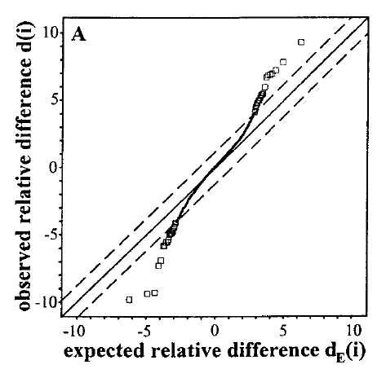

Slide 16
Empirical Bayesian Method
Lönnstedt and Speed (2002) proposed an empirical Bayesian method for two-colored microarray data.
“To use all our knowledge about the means and variances we collect the information gained from the complete set of genes in estimated joint prior distributions for them.”

Slide 17
Lönnstedt and Speed (2002)

Slide 18
Lönnstedt and Speed (2002)
The densities are then

Slide 19
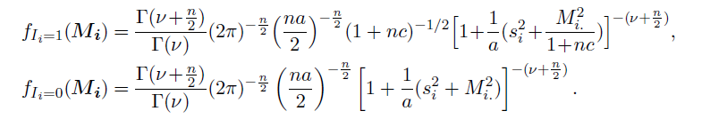
Lönnstedt and Speed (2002)
The log posterior odds of differentially expression for gene g

Slide 20
LIMMA
Smyth (2004) generalized Lönnstedt and Speed’s method to a linear model frame work.
Their method can be applied to both single channel and two-colored arrays.
They also reformulate the posterior odds statistics in terms of a moderated t statistic.

Slide 21
LIMMA-Linear Model
Let be the response vector for the g^{th} gene.
  For single channel array, this could be the log-intensities.
  For two-color array, this could be the log transformed ratio.

Slide 22
LIMMA-Linear Model
Assume
For a simple two group (say n=3 per group) comparison,
Assume

Slide 23
LIMMA-Linear Model
Contrast of the coefficients that are of biological interest . For the simple two group example, .
With known W_{g},

Slide 24
LIMMA-Test of Hypothesis

Slide 25
LIMMA-Hierarchical Model
To describe how the unknown coefficients and vary across genes.
Assume the proportion of genes that are differentially expressed to be .
Prior for : .
Prior for : .

Slide 26
LIMMA-Hierarchical Model
Under the assumed model, the posterior mean of is
The moderated t-statistic becomes:

Slide 27
LIMMA—Relation to Lönnstedt’s Model
Lönnstedt’s method is a specific case of LIMMA. In case of replicated single sample case, re-parameter the model as the following:

Slide 28
Multiple Testing—Basic Concepts
In a high throughput dataset, we are testing hundreds of thousands of hypothesis.
Single test type I error rate :
If we are testing m=10000 hypotheses at
the expected false discovery=

Slide 29
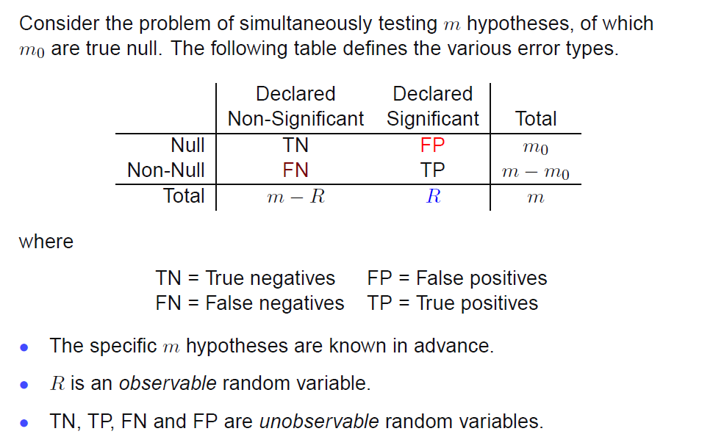
Basic Concepts
Schartzman ENAR high dimensional data analysis workshop

Slide 30
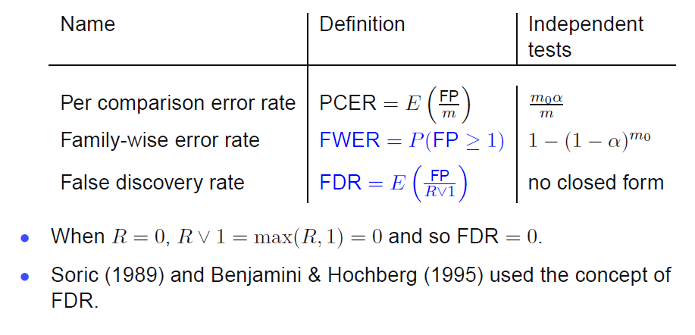
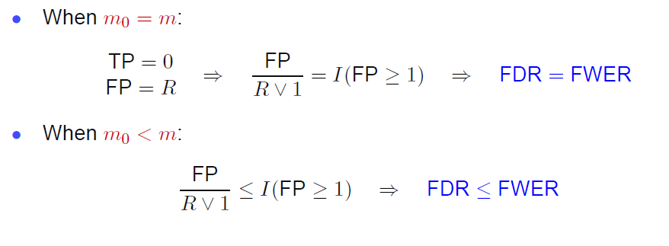
1
Schartzman ENAR high dimensional data analysis workshop

Slide 31
Control vs. Estimation
Control for Type I Error
  For a fixed level of , find a threshold of the statistics to reject the null so that the error rate is controlled at level .
Estimate Error: for a given threshold of the statistics, calculate the error level for each test.

Slide 32
Control of FWER

Slide 33
Single Step Procedure– Bonferroni procedure
To control the FWER at α level, reject all the tests with p<α/m.
The adjusted p-value is given by .
The Bonferroni procedure provides strong control FWER under general dependence.
Very conservative, low power.

Slide 34
Step-down Procedures—Holm’s Procedure
Let be the ordered unadjusted p-values.
Define
Reject hypotheses
If no such j* exists, reject all hypotheses.
Adjusted p-value
Provide strong control of FWER.
More powerful than the Bonferroni’s procedure.

Slide 35
Step-up Procedures
Begin with the least significant p-value, p_{m}.
Based on Simes inequality:

Slide 36
The Hochberg Step-up Procedure
Step-up analog of the Holm’s step-down procedure.
, reject hypothesis H_{j ,} for j=1,…,j*.
Adjusted p-value:
.

Slide 37
Controlling of FDR

Slide 38
Benjamini and Hochberg’s (BH) Step-up Procedure

Slide 39
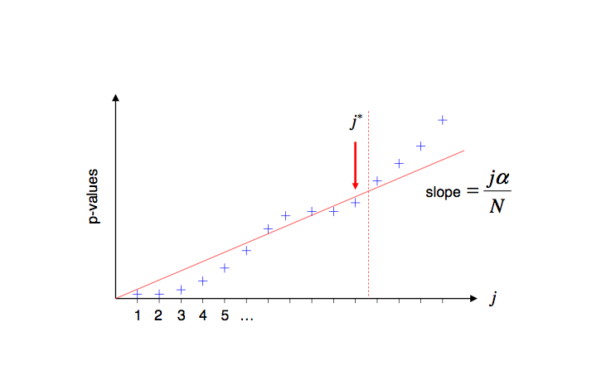
Schartzman ENAR high dimensional data analysis workshop

Slide 40
Benjamini and Hochberg’s (BH) Step-up Procedure
Conservative, as it satisfies
Benjamini and Hochberg (1995) proves that this procedure provides strong control of the FDR for independent test statistics.—see word document for proof.
Benjamini and Yekutieli (2001) proves that BH also works under positive regression dependence.

Slide 41
Benjamini and Yekutieli Procedure
Benjamini and Yekutieli (2001) proposed a simple conservative modification of BH procedure to control FDR under general dependence.
It is more conservative than BH.

Slide 42
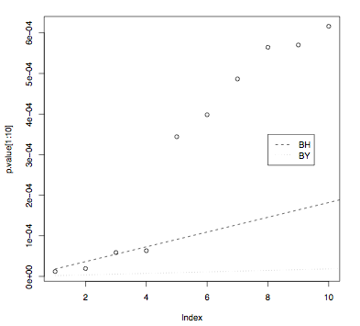
Schartzman ENAR high dimensional data analysis workshop

Slide 43
FDR Estimation
For a fixed threshold, t for the p-value, estimate the FDR.
FP(t): number of false positives.
R(t): number of rejected null hypotheses.
p₀: proportion of true null.
Schartzman ENAR high dimensional data analysis workshop

Slide 44
FDR Estimation
Storey et al. (2003)

Slide 45
Estimation of p₀
Set p₀=1 to get a conservative estimate of FDR. This will lead to a procedure equivalent to BH procedure.
Estimate p₀ using the largest p-values that are most likely come from the null (Storey 2002). Under the assumption of independence, these distribution are uniformly distributed. Hence, the estimate of p₀ is
for a well chosen λ.

Slide 46
P-values generated from a melanoma brain met data comparing brain met to primary tumor.
After filtering out probes with poor quality, we have a total of m=15776 probes.
T-test was applied to the log transformed intensity data.
Here we assume the p-values >λ are from the null, and uniformly distributed. Hence, if p₀=1, then the expected number of p-values in the gray area is (1-λ)m. Thus the estimate of the p₀ is given by (observed number of p-values in this area / (1-λ)m).
λ

Slide 47
Choice of λ
Large λ, more likely the p-values are from null hypothesis, but have less data point to estimate the uniform density.
Small λ, more data points are used, however, may have “contaminations” from non-null hypothesis.
Storey 2002 used a bootstrap method to pick λ that minimize the mean-square error of the estimate of FDR (or pFDR).

Slide 48
SAM

Slide 49
Estimating FDR for a Selected Δ in SAM
For a fixed Δ, calculate the number of genes with for each permutation. These are the estimated number of false positives under the null.
Multiply the median of the estimated number of false positives by p_{0.}
FDR=(median of the number of false discoveries x p₀)/m.

Slide 50
The Concept of Q-values
Similar in spirit to the p-values. The smaller the q-values, the stronger the evidence against the null.
FDR-controlling empirical Bayes q-value-based procedure: to control pFDR at level α, reject any hypothesis with q-value<α. The adjusted p-value is simply the q-value.

Slide 51
Empirical Null (Efron 2004)
Assume the following mixture model for the statistics of the hypotheses:
The problem is the choice of .
  Theoretical null
  Empirical null

Slide 52
The Breast Cancer Example
Compare expression profile of 3,226 genes between 7 patients with BRCA1 mutant and 8 patients with BRCA 2 mutant.
Two sample t-statistic y_{i} was used.
The statistic y_{i} is converted to z-values:

Slide 53
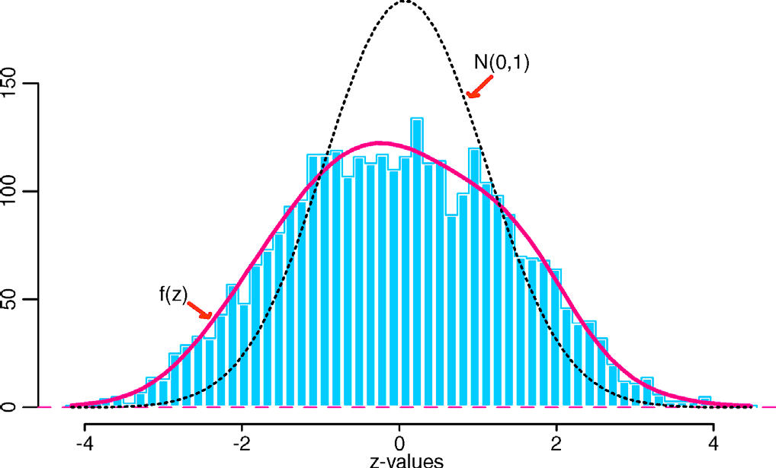
Distribution of the z-values
Theoretical Null: N(0,1)
Yields 35 genes with fdr<0.1.
Empirical Null: N (-.02, 1.58²)
no interesting gene at fdr<0.9
Efron 2004
Notes:
The central peak is wider here than in Figure 1, with center- width estimates .±0;3⁄40/ D .¡:02;1:58/. More importantly, the histogram seems to be all central peak, with no interest- ing outliers such as those seen at the left of Figure 1. This was re􏰷 ected in the local fdr calculations; using the theoreti- cal N.0; 1/ null yielded 35 genes with fdr.zi / < :1, those with jzij>3:35;usingtheempiricalN.¡:02;1:582/null,nogenes at all had fdr < :1—or, for that matter, fdr < :9, the histogram infactbeingalittleshort-tailedcomparedwithN.¡:02;1:582/.

Slide 54
What cause the empirical null differ from the theoretical null?
Unobserved covariates in an observational study.
  Efron (2004), “Large-Scale Simultaneous Hypothesis Testing: The Choice of a Null Hypothesis”, JASA 99: 96-104
Hidden correlations (the breast cancer example).
  Efron (2007), ”Size, Power, and False Discovery Rates”, Ann Statist 35: 1351-1377

Slide 55
Unobserved covariate: a hypothetical example.
The data, x_{ij} , come from N simultaneous two-sample experiments, each comparing 2n subjects,
Y_{i}=two sample t-statistic for test i.

Slide 56
Unobserved covariate: a hypothetical example (continued)
True model:
Then, it could be shown that Y_{i} follow a a dilated t-distribution with 2n-2 df.

Slide 57
Fitting an empirical null
Assume:
  Number of test is large.
  P₀ is large
Different for different theoretical null.

Slide 58
Fitting an empirical null for N(0,1)
Estimation of p₀f₀(t): Suppose the test statistics are z-scores.
If p₀ is close to 1 and m is large, then around the bulk of the histogram, f(t) ≈ p₀f₀(t) while we expect the non-nulls to be mostly in the tails.
Assuming that the empirical null density is f₀(t) = N (μ, σ²), the
parameters μ and σ are estimated by fitting a Gaussian to f(t) by OLS.
The fit is restricted to an interval around the central peak of the histogram, say between the 25th and 75th percentiles of the data.
Notes:
• If we believe the theoretical null, the estimation of p₀ alone can be seen as a special case when μ=0 and σ² =1 are fixed.
• The locfdr package offers other methods for estimating the empirical null such as restricted MLE (Efron, 2006).
Schartzman ENAR high dimensional data analysis workshop

Slide 59
Empirical Null Summary
The empirical null is an estimate of the f₀(t).
It is appropriate than the theoretical null if we are looking for interesting discoveries.
It can make a big difference in the results under certain scenarios.

Slide 60
R packages
Schartzman ENAR high dimensional data analysis workshop

Slide 61
References
DE Analysis
Tusher VG, Tibshirani R, Chu G (2001), “Significance analysis of microarrays applied to the ionizing radiation response”, PNAS 98(9) 5116-5121.
Baldi P, Long AD. A Bayesian framework for the analysis of microarray expression data: regularized t-test and statistical inferences of gene changes. Bioinformatics 2001; 17:509–519.
Lönnstedt I, Speed TP. Replicated microarray data. Statistica Sinica 2002; 12:31–46.
Smyth GK. Linear models and empirical Bayes methods for assessing differential expression in microarray experiments. Statistical Applications in Genetics and Molecular Biology 2004; 3(1):3.
Cui X, Hwang JTG, Qiu J, Blades NJ, Churchill GA. Improved statistical tests for differential gene expression by shrinking variance components estimates. http://www.jax.org/sta/churchill/labsite/pubs/shrinkvariance10.pdf [May 14 2004].
Wright GW, Simon RM. A random variance model for detection of differential gene expression in small microarray experiments. Bioinformatics 2002; 19:2448–2455.

Slide 62
References
Multiple Testing
Dudoit and van der Laan (2008). Multiple Testing Procedures with Applications to Genomics, Springer Series in Statistics.
Dudoit, Shaffer, and Boldrick (2003), “Multiple hypothesis testing in
microarray experiments”, Statistical Science 18: 71-103.
Benjamini and Hochberg (1995), “Controlling the false discovery rate: a practical and powerful approach to multiple testing”, JRSS-B, 57: 289-300.
Benjamini and Yekutieli (2001), “The control of the false discovery rate in multiple testing under dependency”, Ann Statist, 29: 1165-1188.
Storey (2002), “A direct approach to false discovery rates”, JRSS-B 64: 479-498.
Storey (2003), “The positive false discovery rate: a Bayesian interpretation and the q-value”, Ann Statist 31: 2013-2035.
Storey, Taylor, and Siegmund (2004), “Strong control, conservative point estimation and simultaneous conservative consistency of false discovery rates: a unified approach”, J R Statist Soc B, 66: 187-205.
Genovese and Wasserman (2004), “A stochastic process approach to false discovery control”, Ann Statist 32: 1035-1061.
Efron (2004), “Large-Scale Simultaneous Hypothesis Testing: The Choice of a Null Hypothesis”, JASA 99: 96-104.
Efron (2007), “Correlation and Large-Scale Simultaneous Significance Testing”, JASA 102: 93-103

